Slide 1
The Literature Review
Jane Schmidt
Faculty of Community Services Liaison Librarian

Slide 2
Agenda
Who am I and how do I know this stuff?
What is a literature review and why do we do them?
The narrative review
Searching
Appraisal
Synthesis
Analysis
The systematic review
In-class exercise
Questions

Slide 3


Slide 4
The SALSA Framework
Search
Appraisal
Synthesis
Analysis
Notes:
All literature reviews seek to accomplish these tasks, but not all lit reviews are the same, and different kinds will seek to accomplish these goals to varying degrees.

Slide 5
Why do we do literature reviews?
Research is iterative and depends upon asking increasingly complex or new questions whose answers in turn develop additional questions or lines of inquiry in any field.
Searching for information is often nonlinear and iterative, requiring the evaluation of a range of information sources and the mental flexibility to pursue alternate avenues as new understanding develops.
Source: ACRL Information Literacy Framework for Higher Education, 2016

Slide 6
The narrative literature review
What is already known about this area? What is not known?
What concepts and theories are relevant?
What research methods and strategies have been employed in studying this area?
Are there any significant controversies?
Are there any inconsistencies in the findings related to this area?
Are there any unanswered research questions?
Source: Bryman, A., & Bell, E. (2016). Social research methods (4th Canadian Edition). Don Mills, Ontario: Oxford University Press.
Notes:
So - why do we do literature reviews? It’s helpful to keep these goals in mind.
When we are able to answer these questions, we are better able to grasp the ways in which we will contribute to the scholarship in our field.
Similarly, understanding the limitations of our own knowledge is key - how do you know what you don’t know?

Slide 7
A literature review...
Educates the reader/writer on what is known about a topic
Strengthens the writing by knowing what has been established as knowledge and what is not yet known
Helps to establish the author’s credibility through demonstrating a command of what has already been written
Assists in making the argument for the need to explore a research question

Slide 8
Three kinds of narrative literature reviews
Integrative - summarizing past research based on overall conclusions
Theoretical - identifying and critiquing various theories used to explain a phenomenon
Methodological - highlighting different methodological approaches used in past research and the contributions of each type
Source: Andrew S. Denney & Richard Tewksbury (2013) How to Write a Literature Review, Journal of Criminal Justice Education, 24:2, 218-234, DOI: 10.1080/10511253.2012.730617
Notes:
Why is there an issue of overrepresentation in the child welfare system?
Theoretical: how does critical race theory help to explore overrepresentation in the child welfare system?
How has participatory research been conducted to explore overrepresentation in the child welfare system?

Slide 9
Example research questions
General topic: over-representation of Black children in the child welfare system
Integrative:
Why are Black children over-represented in the child welfare system?
Theoretical:
How does critical race theory help to explore overrepresentation of Black children in the child welfare system?
Methodological:
How has participatory research been conducted to explore overrepresentation of Black children in the child welfare system?

Slide 10
A literature review ...
SHOULD:
Have a clear focus on the research question
Draw out the major themes, issues and concepts related to the question
Connect these concepts/themes/issues seamlessly
Reveal what is missing from the scholarship
SHOULD NOT:
Just list the findings of all the articles (Study A found X, Study B found Y)
It should not read like a series of annotations - it is not an annotated bibliography
Source: Andrew S. Denney & Richard Tewksbury (2013) How to Write a Literature Review, Journal of Criminal Justice Education, 24:2, 218-234, DOI: 10.1080/10511253.2012.730617

Slide 11
Let’s look at an example

Slide 12
Search

Slide 13
Create an outline
Determine the initial scope of the task required to meet your information needs.
Notes:
An outline is the map of what you intend to discuss and why. What kind of research are you looking for? What type of lit review are you going to do? Will this mainly be theoretical, or are you interested in evaluating the evidence that has been collected on a particular topic so far? Think through different kinds of research methodologies that are commonly associated with your topic. Which will you focus on? Are there any that you absolutely want to exclude - for example, if I am really interested in Indigenous methods, will I completely exclude quantitative studies? What does that look like? Are there any drawbacks to excluding large swaths of available literature? Am I comfortable enough with a range of research methods to be able to sufficiently analyze and critique their results?

Slide 14
Types of sources to use
Academic journal articles
Books or book chapters
Grey literature including:
Government publications
NGOs or non-profit generated research papers
Theses and dissertations
AVOID: partisan non-profit research, magazine articles, newspaper articles, blogs, opinion articles.

Slide 15
Example research question
Why are Black children disproportionately represented in the child welfare system in Canada?
Notes:
Choose something of interest, but without too narrow a focus. Allow yourself permission and be open to tweaking and changing your mind as you go on. In fact, this will be a likely outcome as you dive deeper in to the literature and see different approaches.

Slide 16
Choosing your keywords
Cast a wide net and become familiar with the available literature as a first step
Don’t be too specific at the outset
Try different combinations and approaches depending on the tool you are using
Be open to new terms as you come across them
Don’t get too hung up on Boolean

Slide 17
Brainstorm concepts and synonyms
Child welfare
Over-representation
Black
Canada (Ontario?)
Disproportionality
Afro-Caribbean
African Canadian
African American
Caribbean
Notes:
Try the easiest one first, take note of new concepts and words - your synonym list can come after you’ve done a preliminary search.

Slide 18
First pass:
Black
Child welfare
Representation
Canada

Slide 19
Refine your search strategy

Slide 20
Sources of information
Search Everything
Google Scholar
Specific Databases
Specific Journals
Snowball method/citation chasing
All of the above
Research Guides
Notes:
Search Everything - child welfare representation Black
Google Scholar - “child welfare” representation Black
Specific Databases - Social Services Abstracts
Specific Journals - Children and Youth Services Review - try Black children canada
Citation chasing
All of the above

Slide 21
Scan the results for relevance:
Go beyond the title
Read the abstract
Identify the research question
Read the conclusion
Make a call on its relevance - be generous at this stage
Take notes on new terms you are finding

Slide 22
Appraisal

Slide 23
Inclusion criteria
Focus on Canadian context
Studies that focus on the Black community
Journals from the social sciences, specifically child and youth care perspective
Non-academic studies conducted by non-partisan NGOs, think tanks or non-profits with a broad focus
Post 2005, with an exception for notable classics or seminal pieces

Slide 24
Exclusion criteria
Studies that singularly focus on non-Canadian populations and are not generalizable
Studies that only make passing mention of the Black community
Journals from the medical sciences/economics
Pre 2005

Slide 25
Synthesis

Slide 26
Getting to your short list
Review your long list:
Have you changed your mind about the direction of your topic?
Can you identify common themes among the articles?
Decide how you feel about the strength of the conclusions drawn
Eliminate those that are only tangentially relevant
Identify areas where you are coming up short; start new targeted searches to shore up those topics

Slide 27
The snowball method
Notes:
If you need more citations… try the snowball method

Slide 28
Two ways
Looking backward:
Mine the bibliography: look to see the works cited in a highly relevant article
Note: there is likely to be grey literature cited. Seek it out, but ensure that you are not leaning too heavily on it for the purposes of your assignment.
Looking forward:
See how an article was received upon publication - how often has it been cited?
Google Scholar or the Library search will show you this information
Works particularly well for older articles, not so well for newer
Can take you in interdisciplinary directions

Slide 29
Once you have the short list:
Do a close read of each item on your short list
Take note of methodologies used, ensure you fully understand them
Read it again
Create a summary of each item and note the themes you have observed

Slide 30
Analysis

Slide 31

Broad research question
Subtopic/theme (broad)
Introduce each subtopic and
explain its relevance
Discuss what is known about it
Weave it into the next subtopic
Conclude by explicitly stating how you will contribute to the further understanding of the topic
Subtopic/theme (narrow)
Subtopic/theme (narrower)
Your unique research question that is yet to be answered
CC0 1.0

Slide 32
Useful tools
Sage Research Methods
Very useful reference resource for research methodology definitions, resources to help with research projects from start to finish
CASP checklists
Especially the CASP Qualitative checklist - helps appraise articles as you read them
SANRA scale
Useful to help you appraise your own work when writing literature reviews

Slide 33
Recommended reading on literature reviews
Andrew S. Denney & Richard Tewksbury (2013) How to Write a Literature Review, Journal of Criminal Justice Education, 24:2, 218-234, DOI: 10.1080/10511253.2012.730617
Sage Research Methods - search for specific terms, or “literature review”
Aveyard, H. (2014). Doing a literature review in health and social care : a practical guide. Retrieved from http://ebookcentral.proquest.com.ezproxy.lib.ryerson.ca
Booth, A., Papaioannou, D., & Sutton, A. (2016). Systematic approaches to a successful literature review (Second ed.) Sage.

Slide 34
The Systematic Review

Slide 35
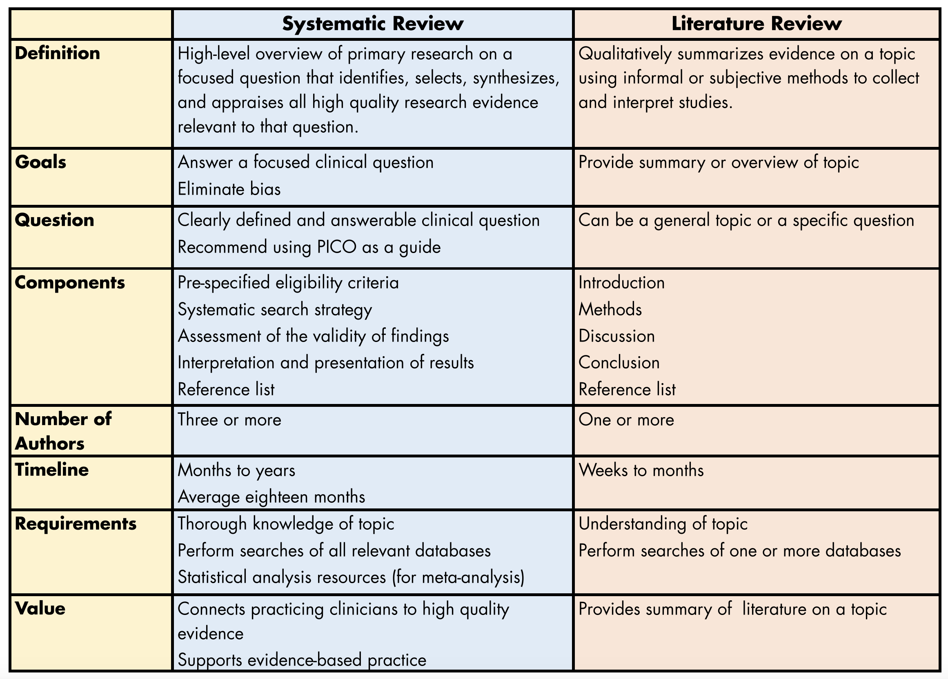
Source: Kysh, Lynn (2013): Difference between a systematic review and a literature review. figshare. Poster.

Slide 36
What is a systematic review?
“A systematic review attempts to collate all empirical evidence that fits pre-specified eligibility criteria in order to answer a specific research question. The key characteristics of a systematic review are: a clearly defined question with inclusion & exclusion criteria; rigorous & systematic search of the literature; critical appraisal of included studies; data extraction and management; analysis & interpretation of results; and report for publication.”
– Duke University Medical Centre & Archives

Slide 37
Who is involved?
A true systematic review should involve a team of people :
Reviewers working independently to screen abstracts,
Subject experts to clarify issues related to the topic,
Statistician to help with data analysis; and a
A project leader to coordinate and write the final report.
A librarian(s) to develop comprehensive search strategies and identify appropriate databases
A systematic review can take at least a year to complete!

Slide 38
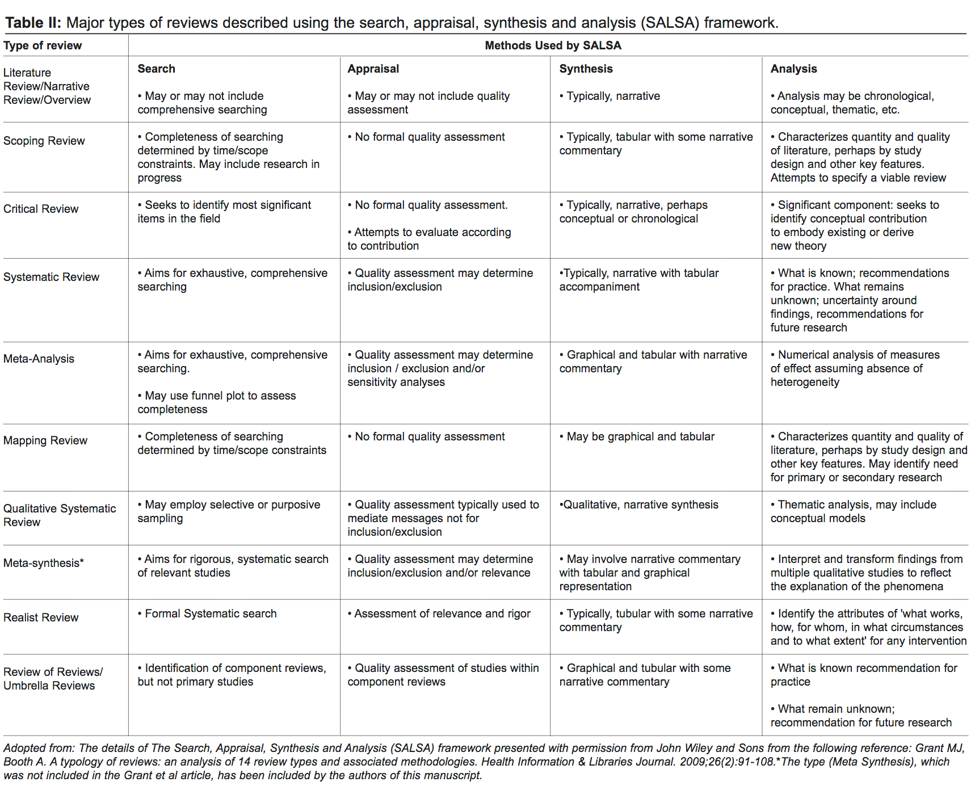
Notes:
There are a LOT of different kinds of literature reviews. [explain framework: SEARCH APPRAISAL SYNTHESIS ANALYSIS] - these are components of ALL lit reviews, there are just different levels of intensity to each one.

Slide 39
Tools
Organizations of note:
Cochrane Collaboration (health sciences)
Campbell Collaboration (social sciences)
Centre for Reviews and Dissemination
Registries:
PROSPERO
Methodology:
PRISM
Critical appraisal tools:
CASP
BestBETS
MMAT checklist
AMSTAR
Bias reduction:
ROBIS
RoB 2

Slide 40
In class exercise

Slide 41
Find a systematic and/or literature review on a topic of interest in your subject area using Search Everything Advanced Search.

